Slide 1
Deep Neural Network and Sequence Models.pptx
HE Huifan
NEC Laboratories Singapore

Slide 2
Syllabus
Overall of Deep Neural Networks
Recursive Neural Network (RNN)
Long Short-term Memory (LSTM)
Use Cases of Sequence Model

Slide 3
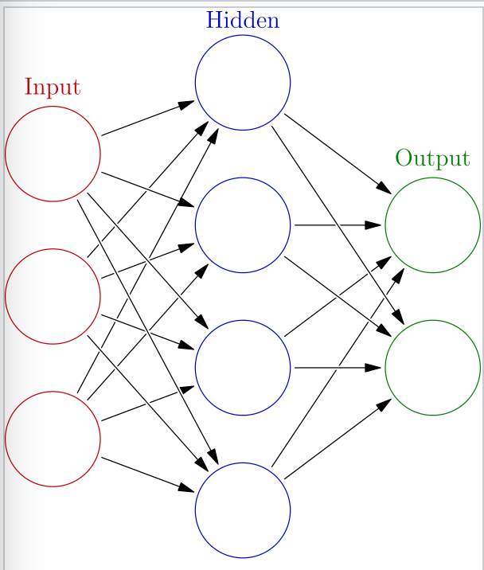
Overall Induction of Deep Learning Model
Deep learning is a class of machine learning algorithms that:
use a cascade of multiple layers of nonlinear processing units for feature extraction and transformation. Each successive layer uses the output from the previous layer as input.
learn in supervised (e.g., classification) and/or unsupervised (e.g., pattern analysis) manners.
learn multiple levels of representations that correspond to different levels of abstraction; the levels form a hierarchy of concepts.
ANN: https://en.wikipedia.org/wiki/Artificial_neural_network
Artificial neural networks (ANN) or connectionist systems are computing systems vaguely inspired by the biological neural networks that constitute animal brains.
An ANN is based on a collection of connected units or nodes called artificial neurons, which loosely model the neurons in a biological brain. Each connection, like the synapses in a biological brain, can transmit a signal from one artificial neuron to another. An artificial neuron that receives a signal can process it and then signal additional artificial neurons connected to it.

Slide 4
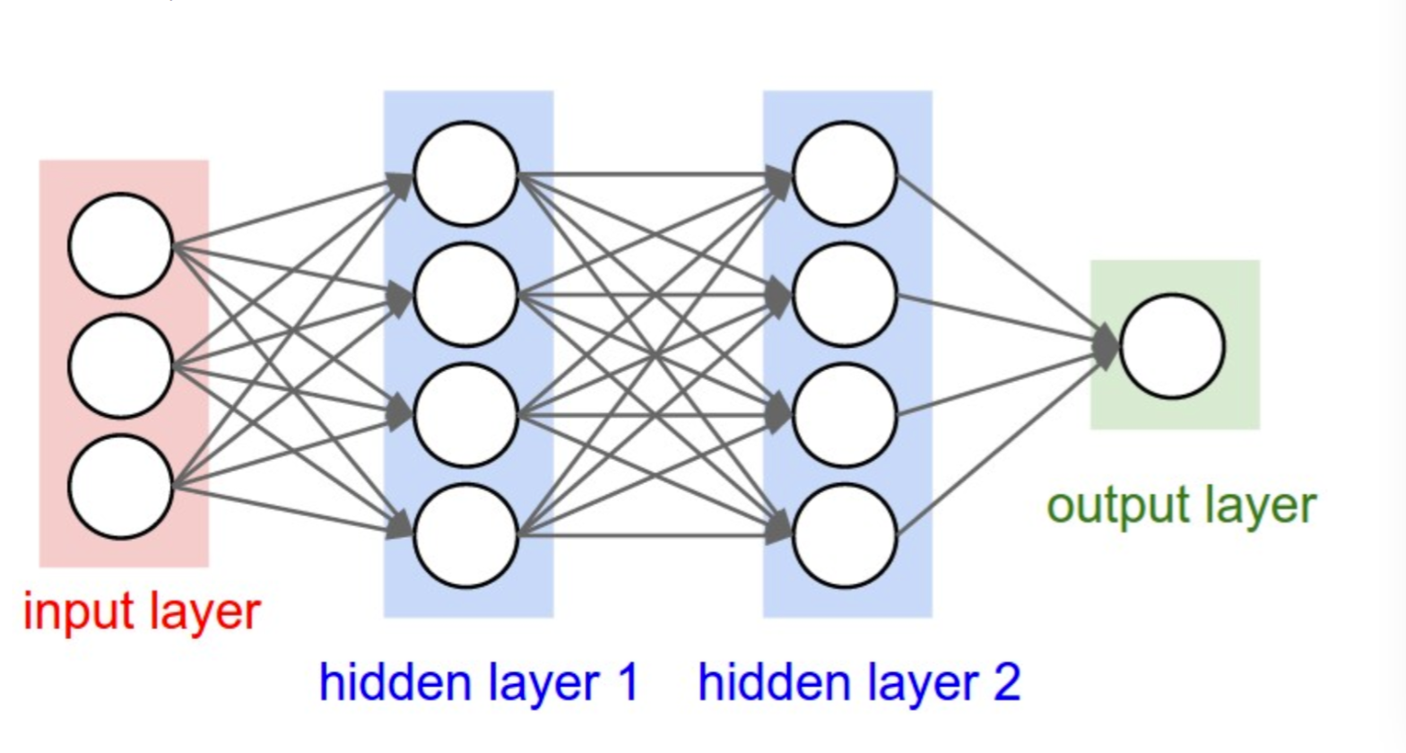
The Structure of Deep Learning Model
Forward Propagation:The input X provides the initial information that then propagates to the hidden units at each layer and finally produce the output. The architecture of the network entails determining its depth, width, and activation functions used on each layer.
Calculate Loss: Measure the difference between the predicted output and real output. (Cross-Entropy, MSE,
etc )
Backward Propagation: Allows the information to go back from the cost backward through the network in order to compute the gradient.
https://towardsdatascience.com/coding-neural-network-forward-propagation-and-backpropagtion-ccf8cf369f76

Slide 5
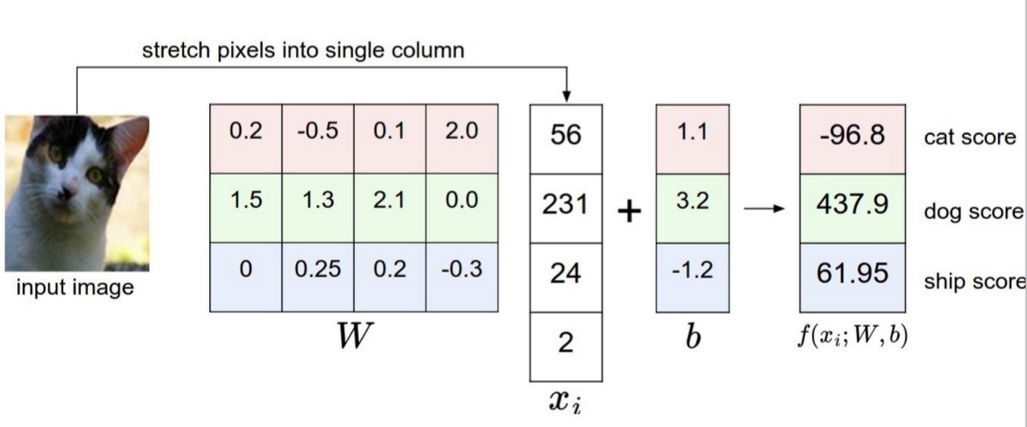
Example:

Slide 6
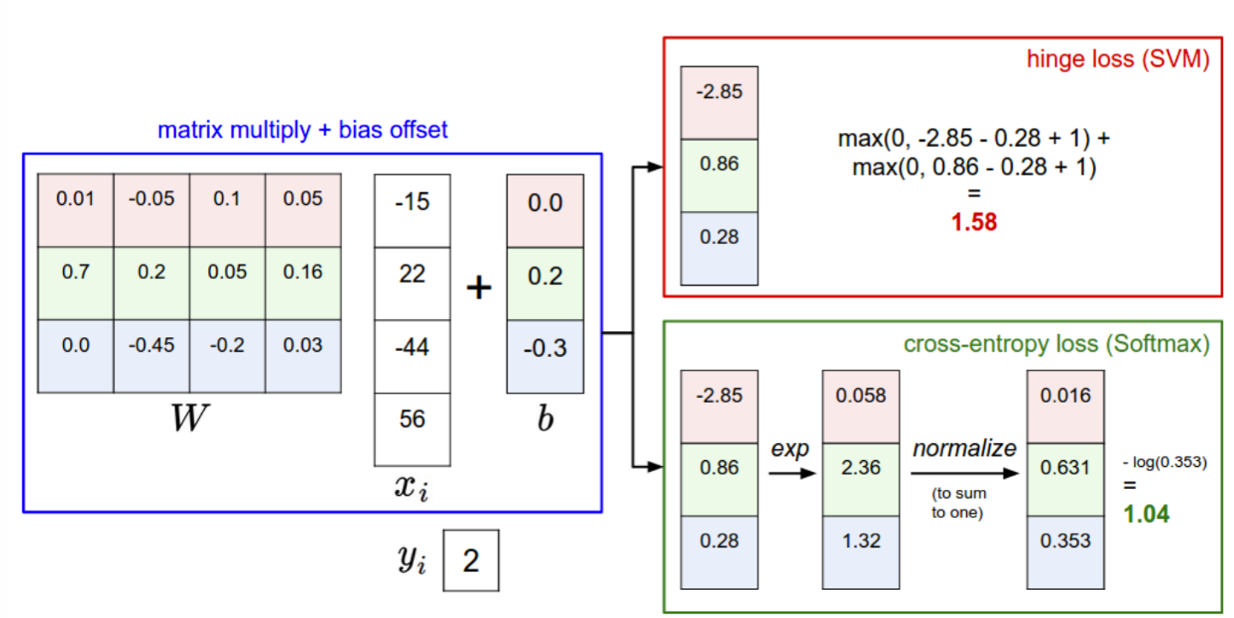
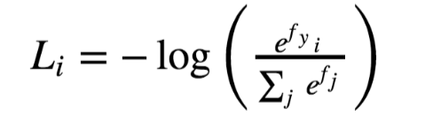
Example:

Slide 7
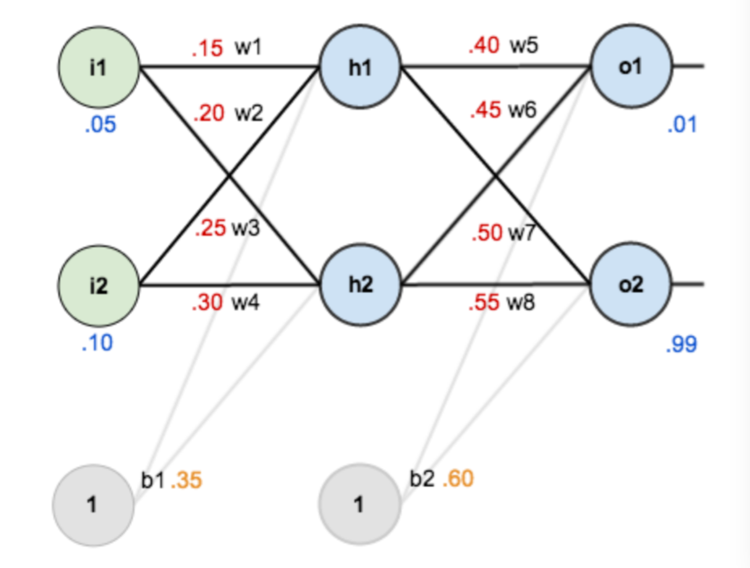
Example

Slide 8
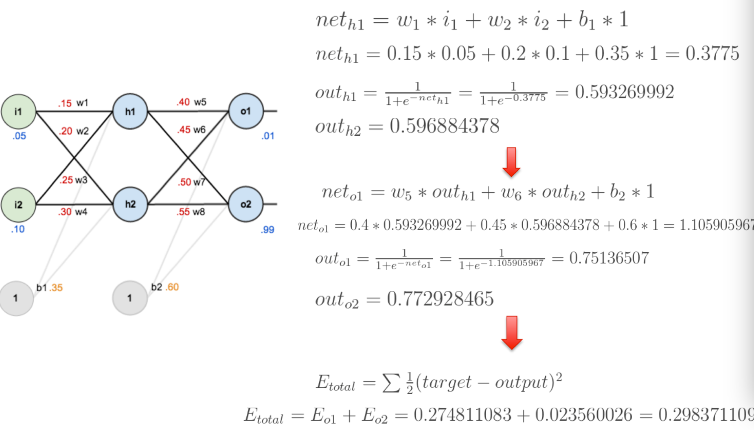
Example: Forward Propagation and Loss Calculation

Slide 9
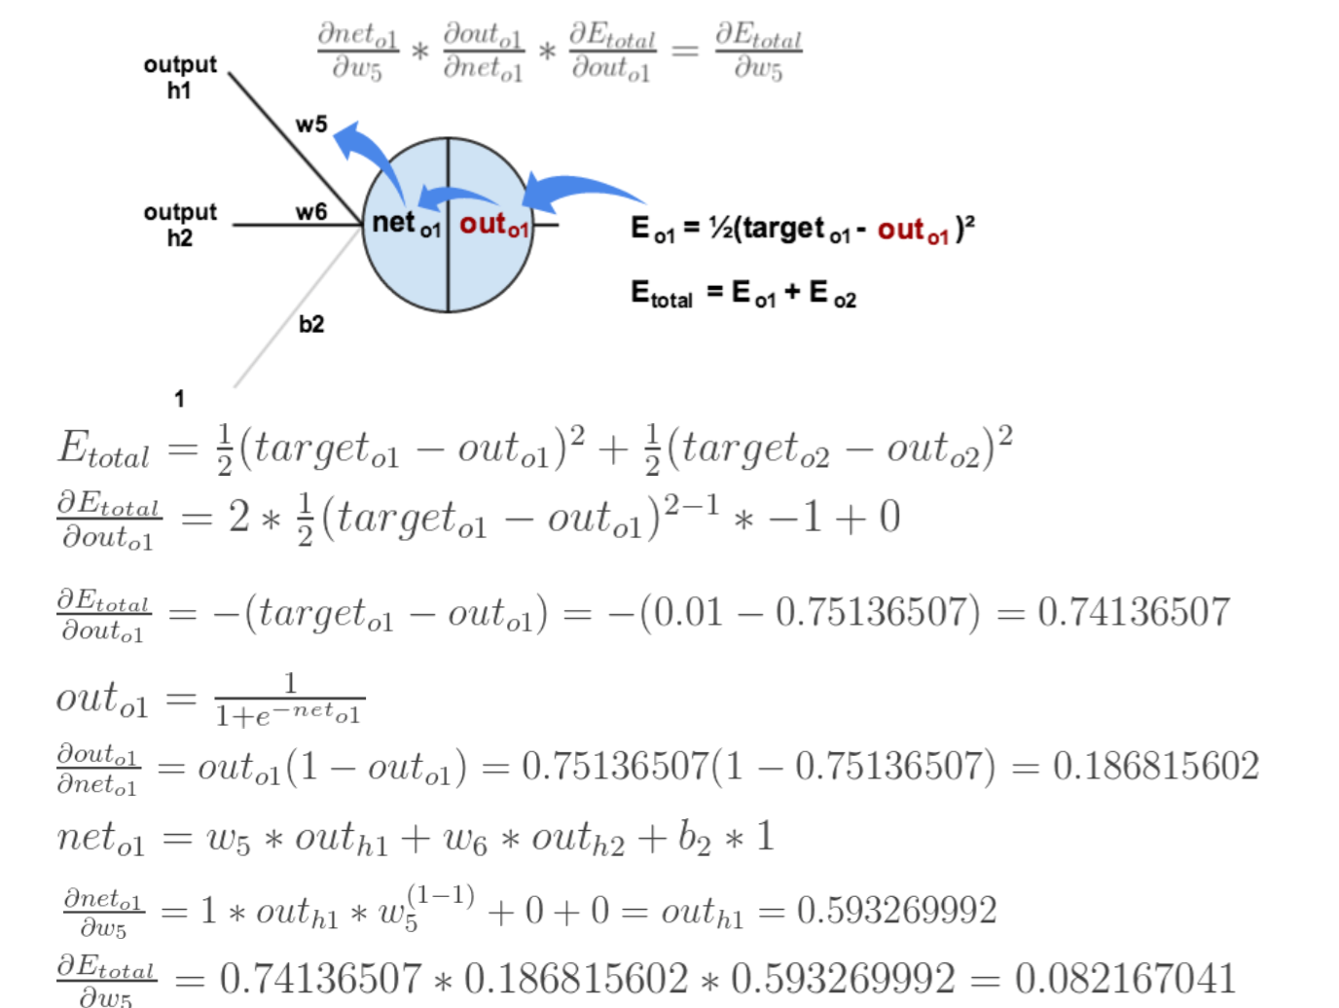
Example: Backward Propagation

Slide 10
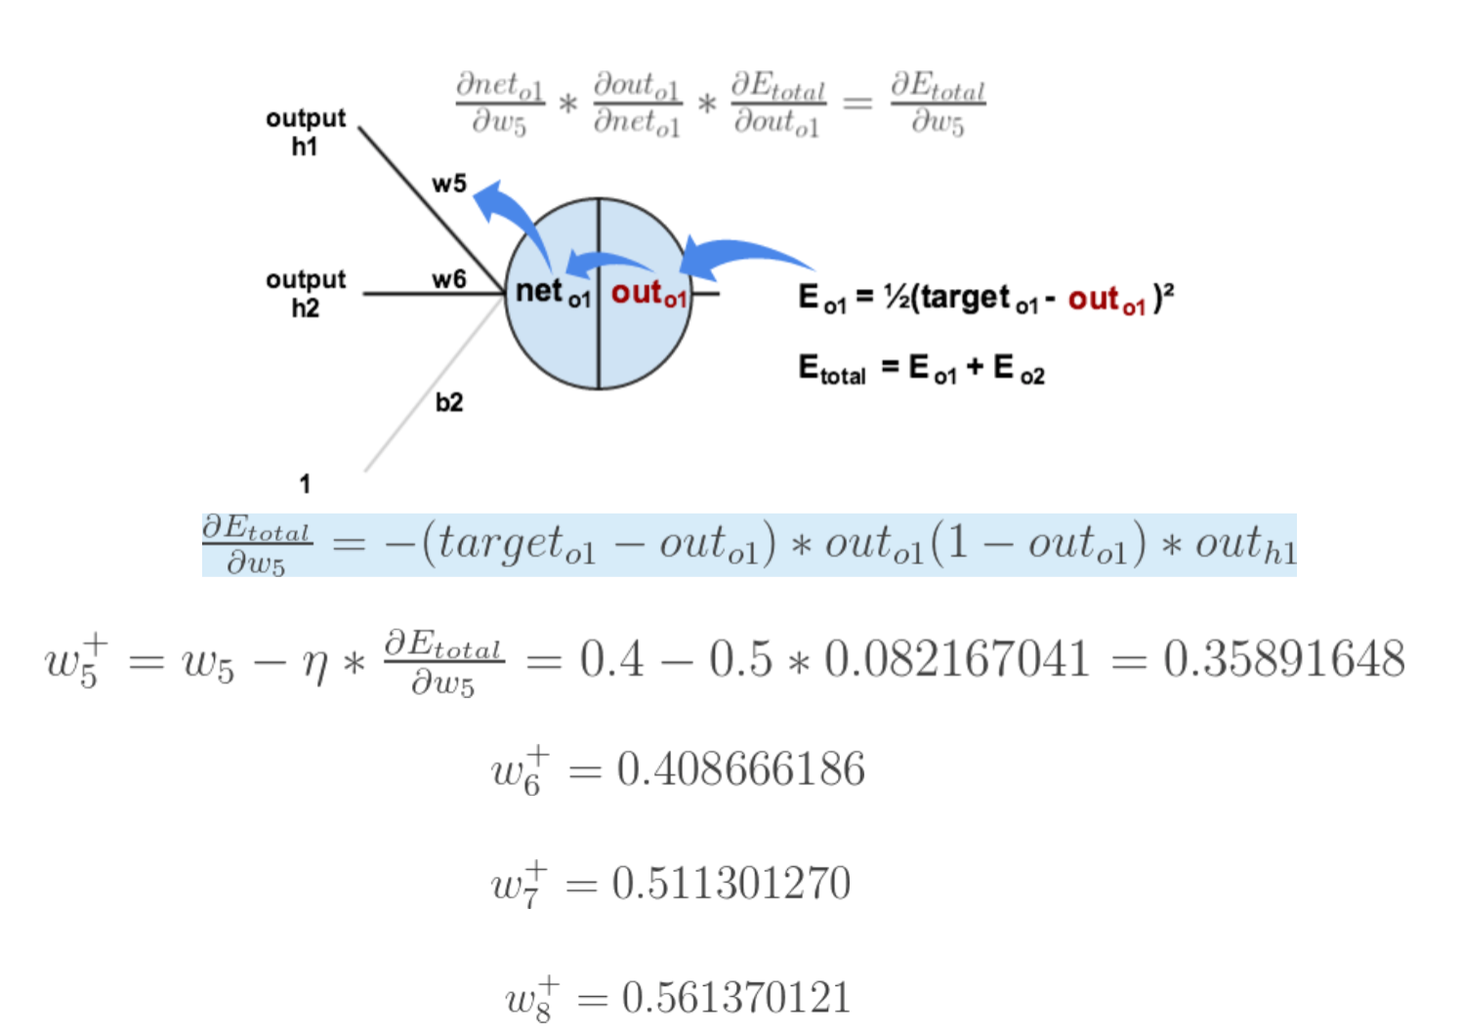
Example: Backward Propagation and Weight Update

Slide 11
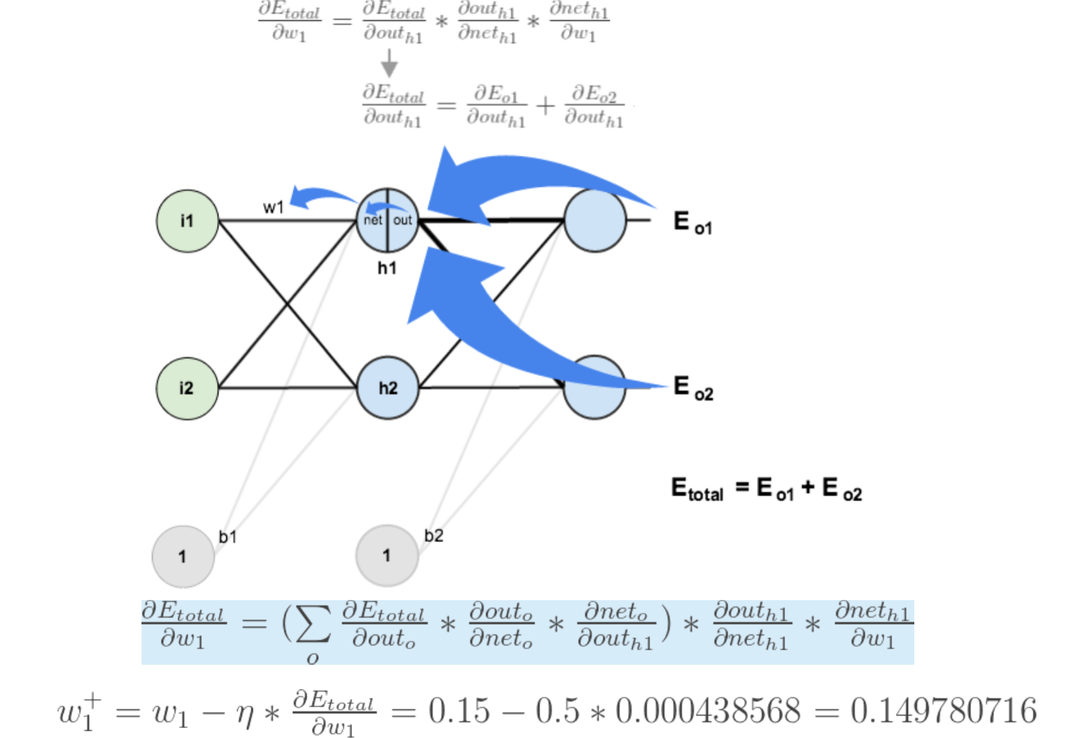
Example: Backward Propagation and Weight Update

Slide 12
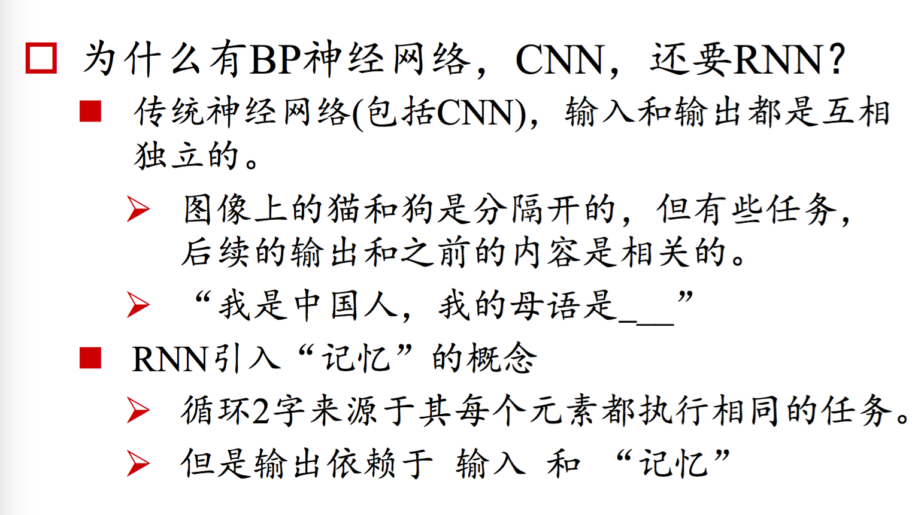
Sequence Model: RNN Overview

Slide 13
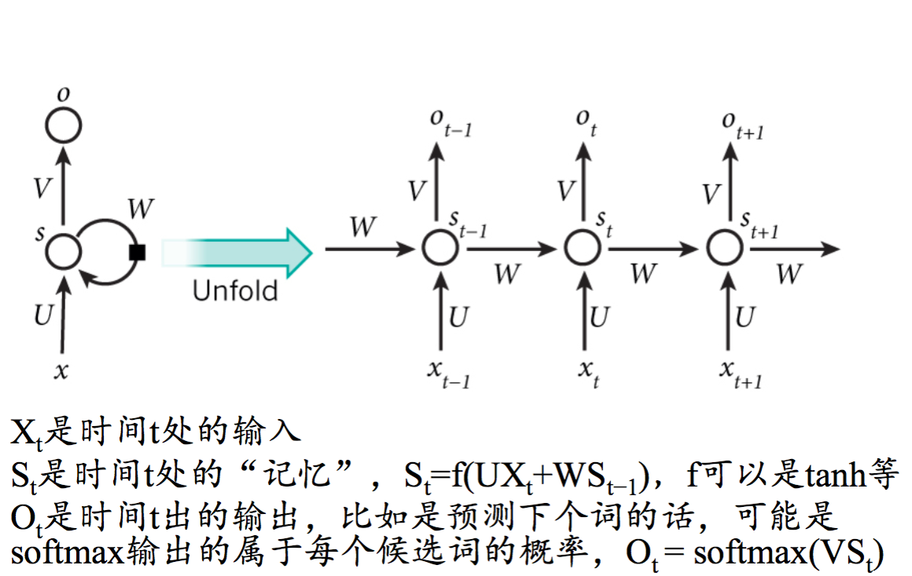
Sequence Model: RNN Structure

Slide 14
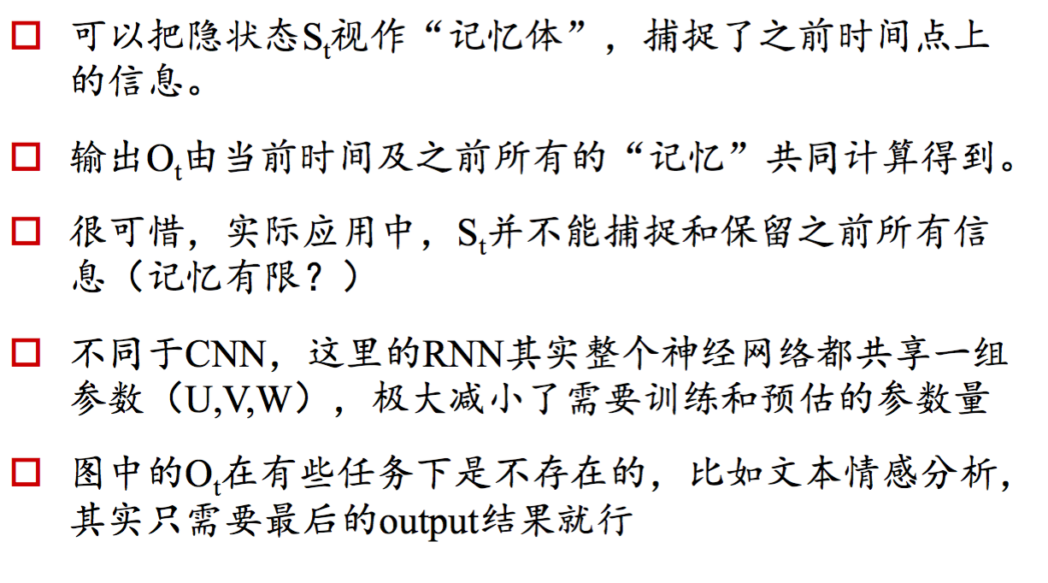
Sequence Model: RNN Structure

Slide 15
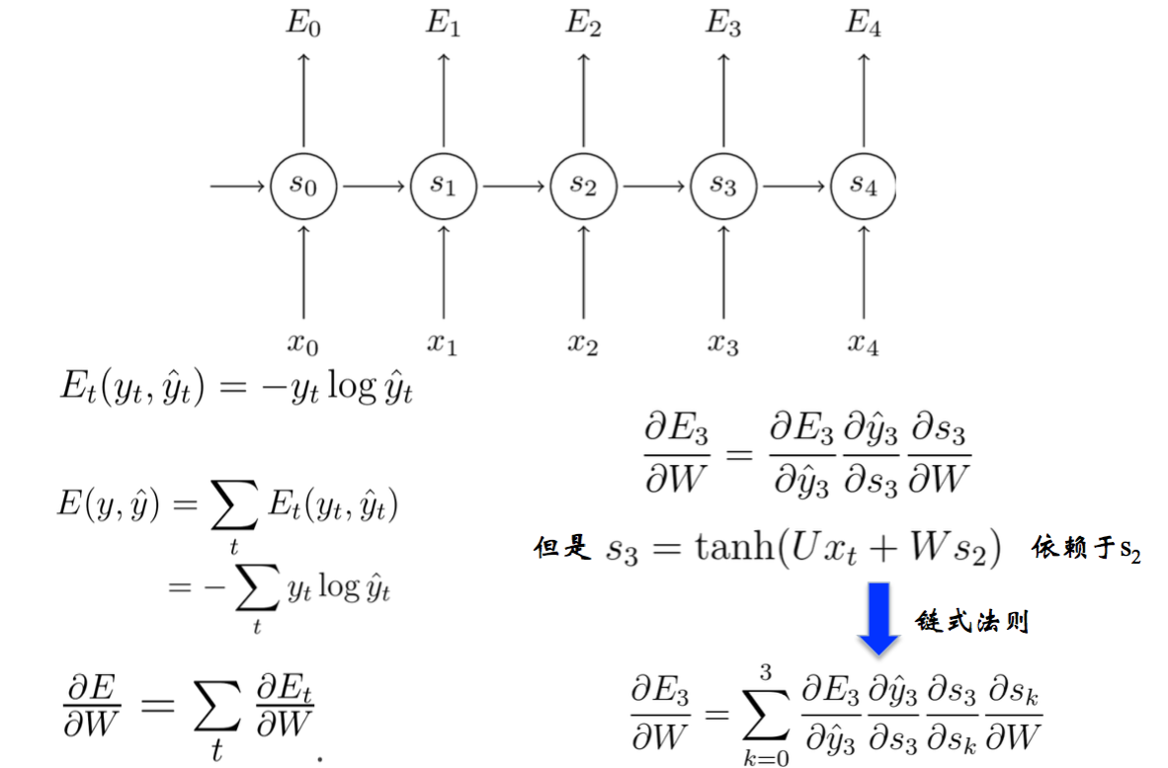
Sequence Model: RNN and BPTT

Slide 16
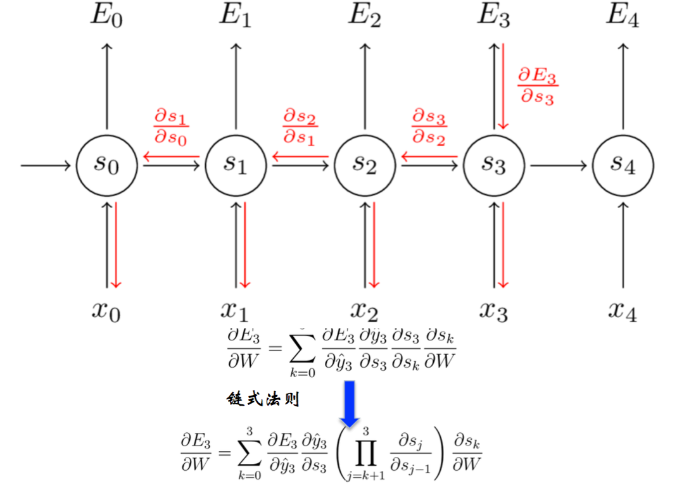
Sequence Model:RNN and BPTT

Slide 17
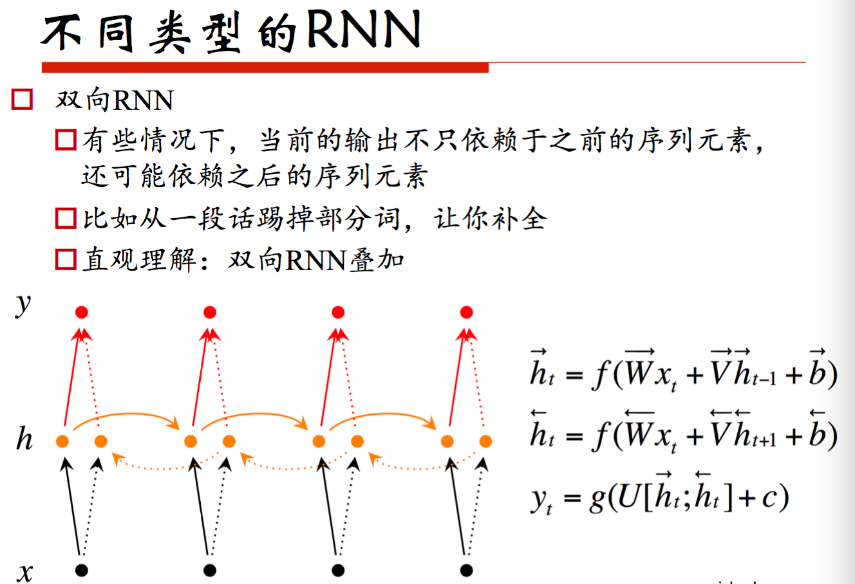
Sequence Model:Bi-direct RNN

Slide 18
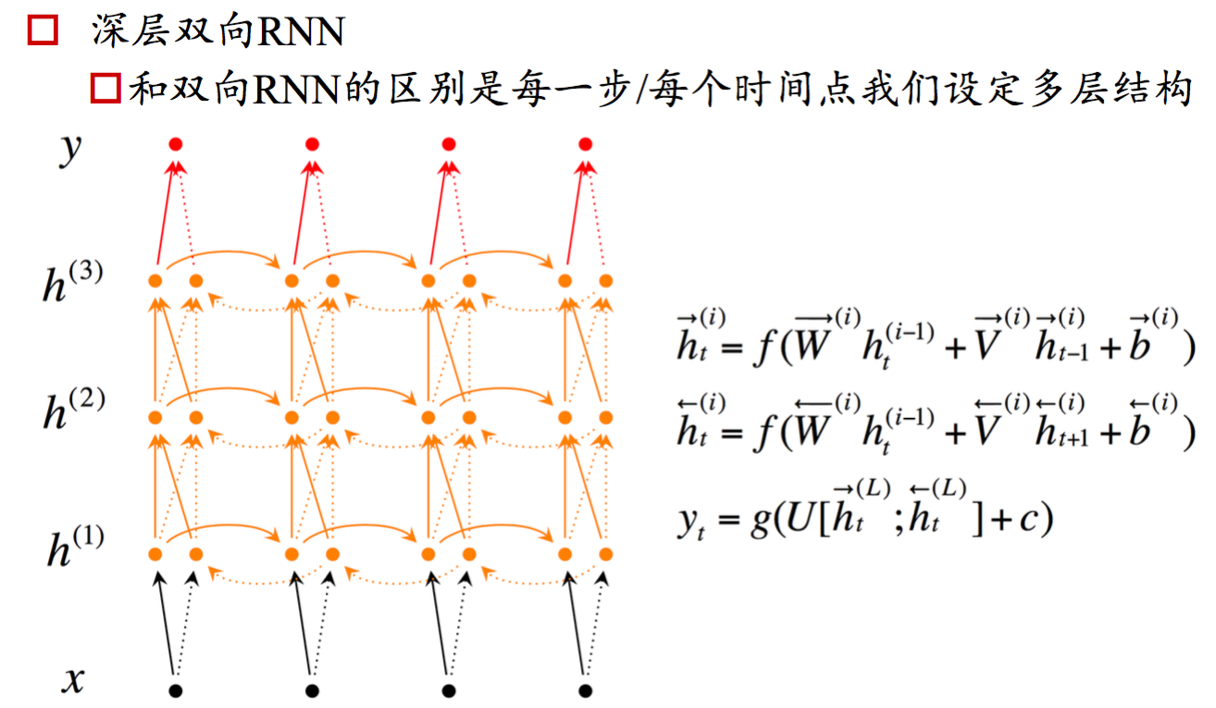
Sequence Model:Bi-direct RNN

Slide 19
Sequence Model:RNN and BPTT

Slide 20
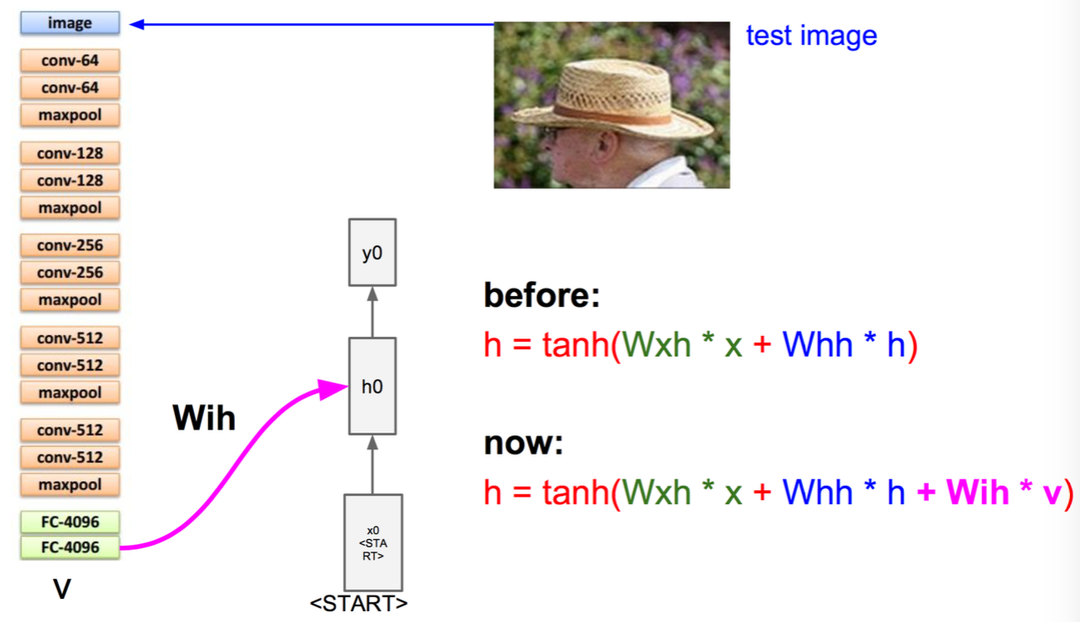
Sequence Model:Image to Text Use Case

Slide 21
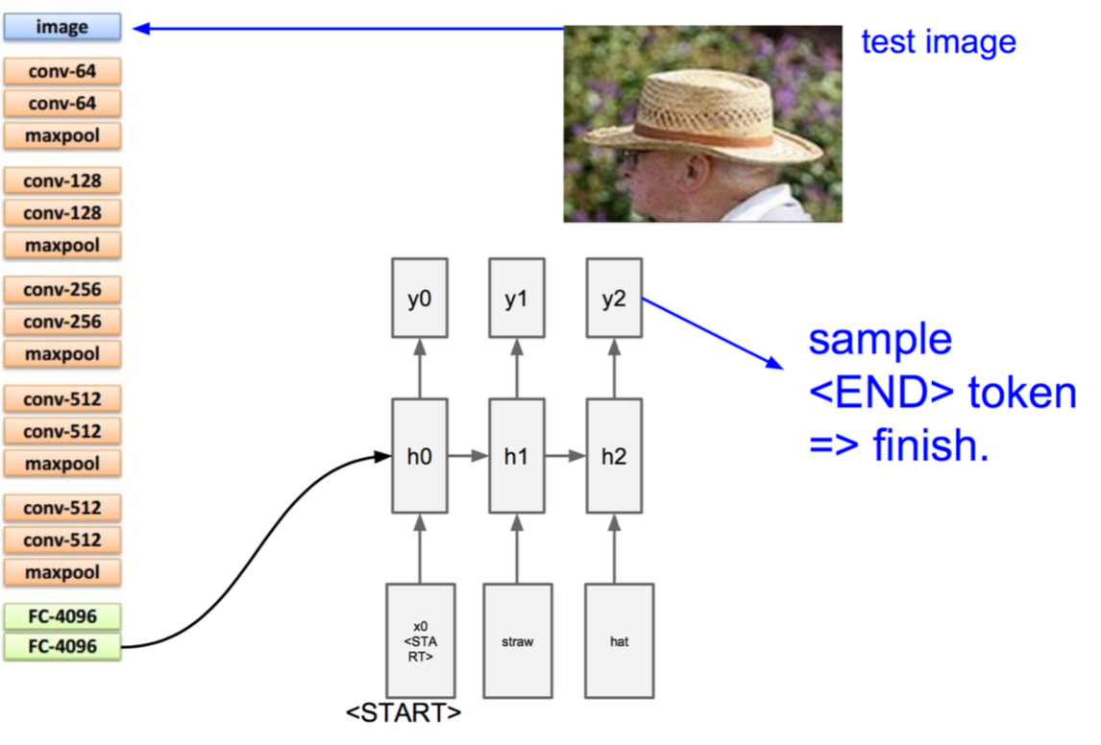
Sequence Model:Image to Text Use Case

Slide 22
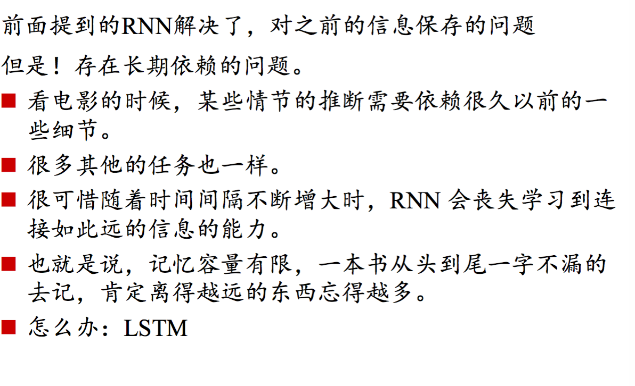
Sequence Model: LSTM

Slide 23
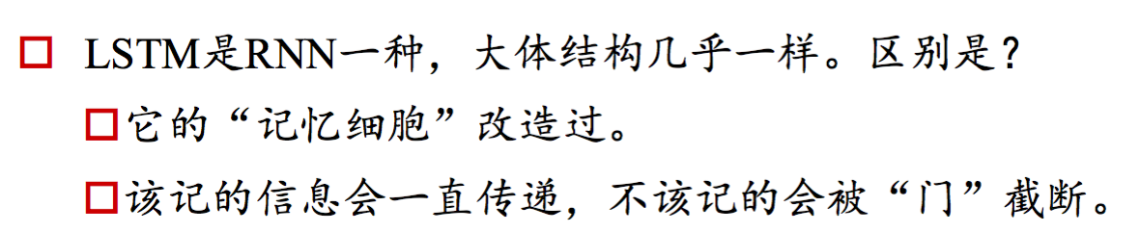
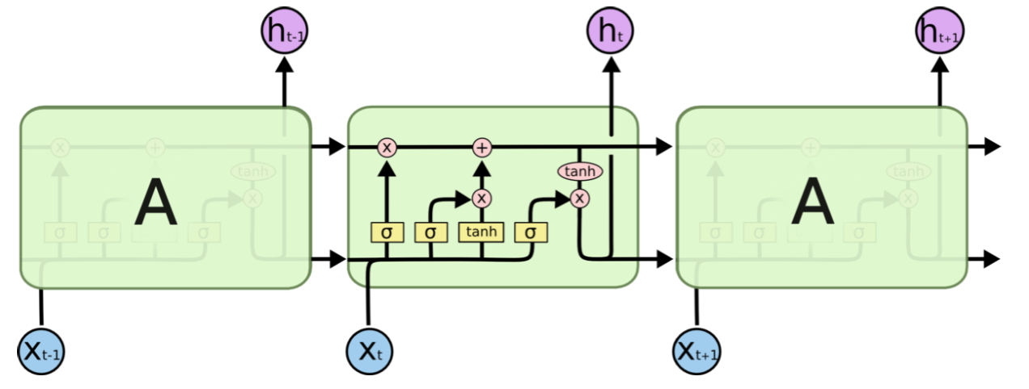
Sequence Model: LSTM

Slide 24
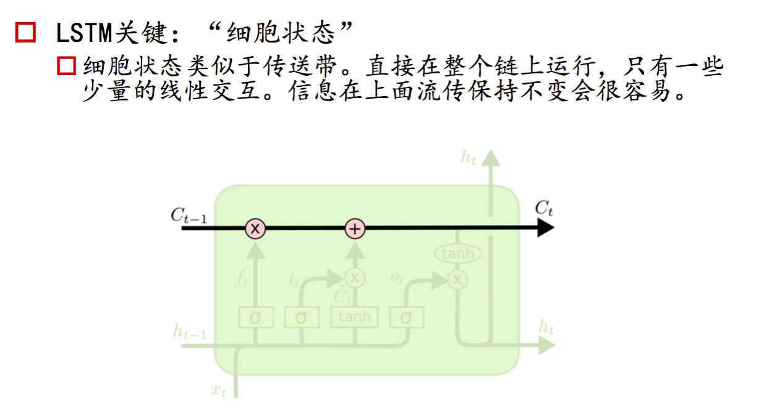
Sequence Model: LSTM

Slide 25
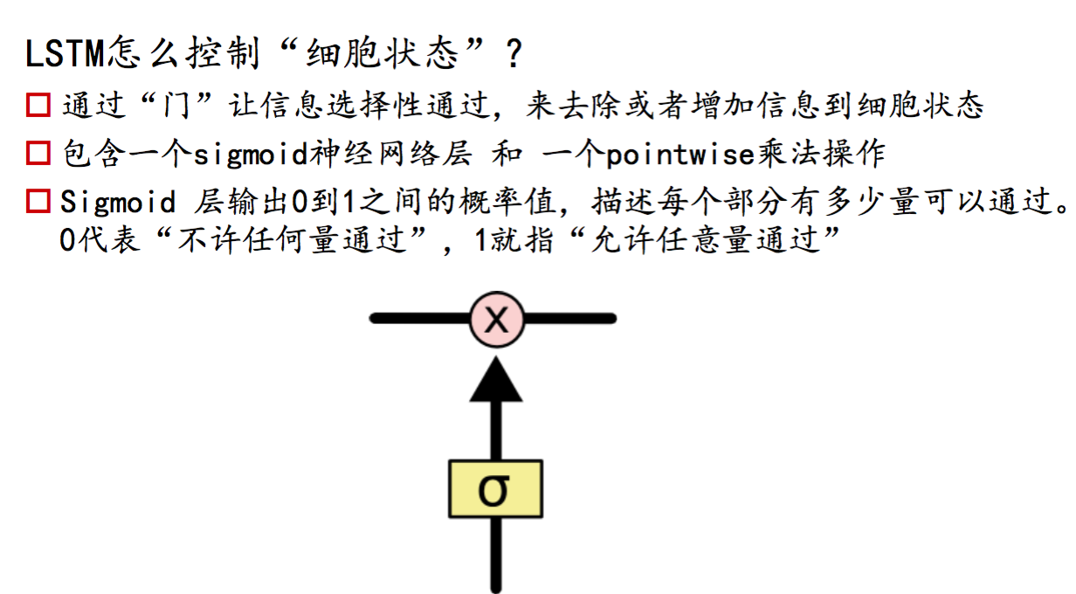
Sequence Model: LSTM

Slide 26
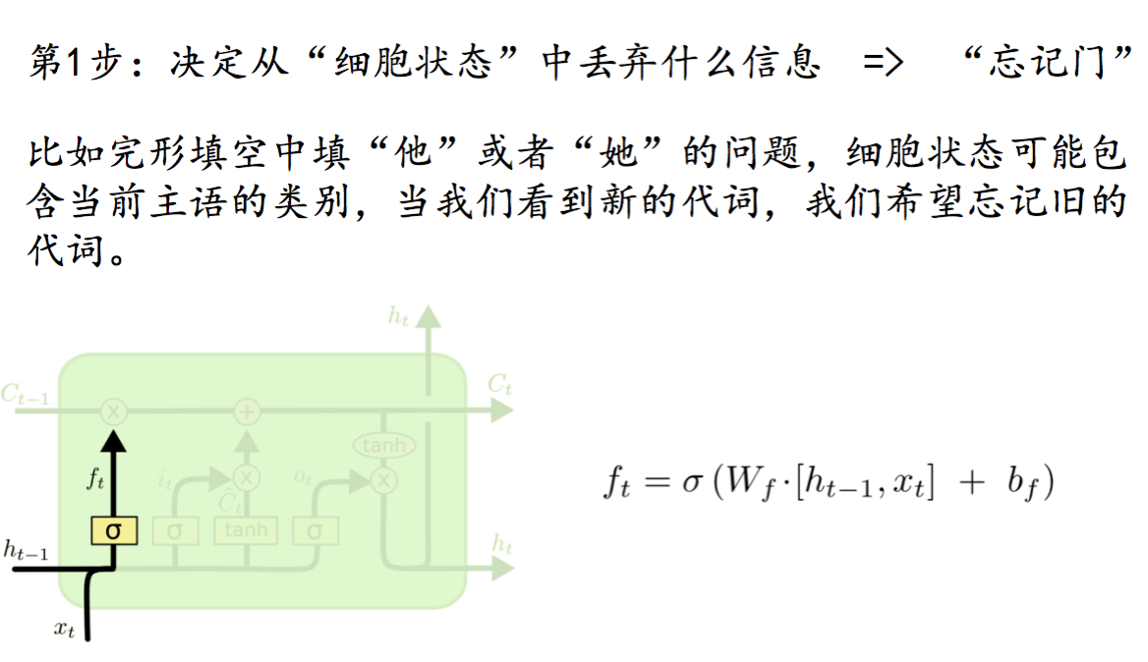
Sequence Model: LSTM Gates

Slide 27
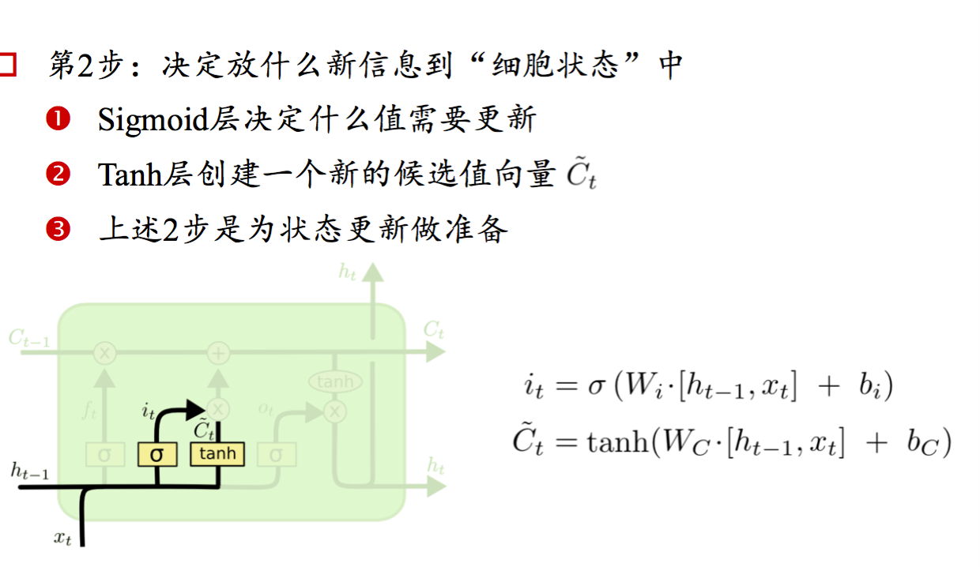
Sequence Model: LSTM Gates

Slide 28
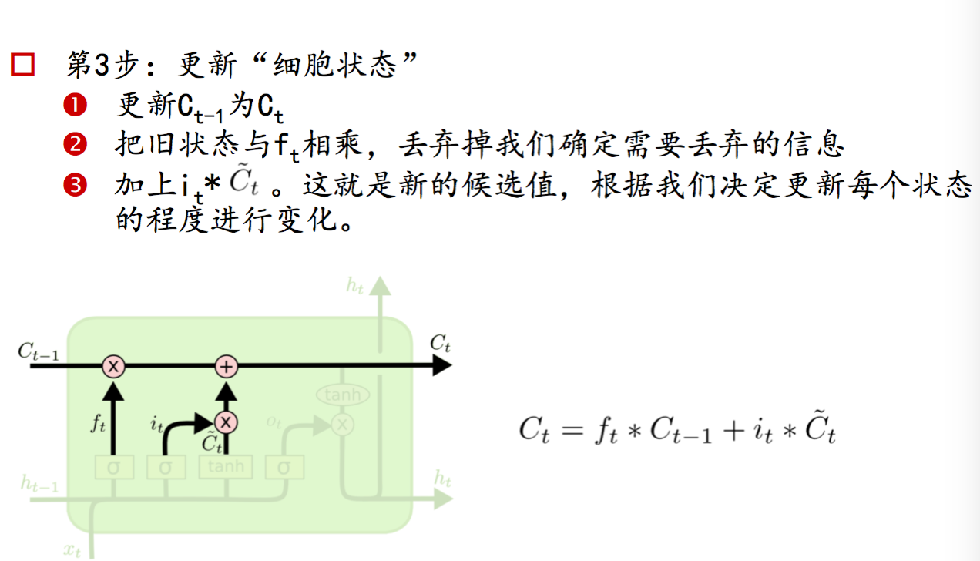
Sequence Model: LSTM Gates

Slide 29
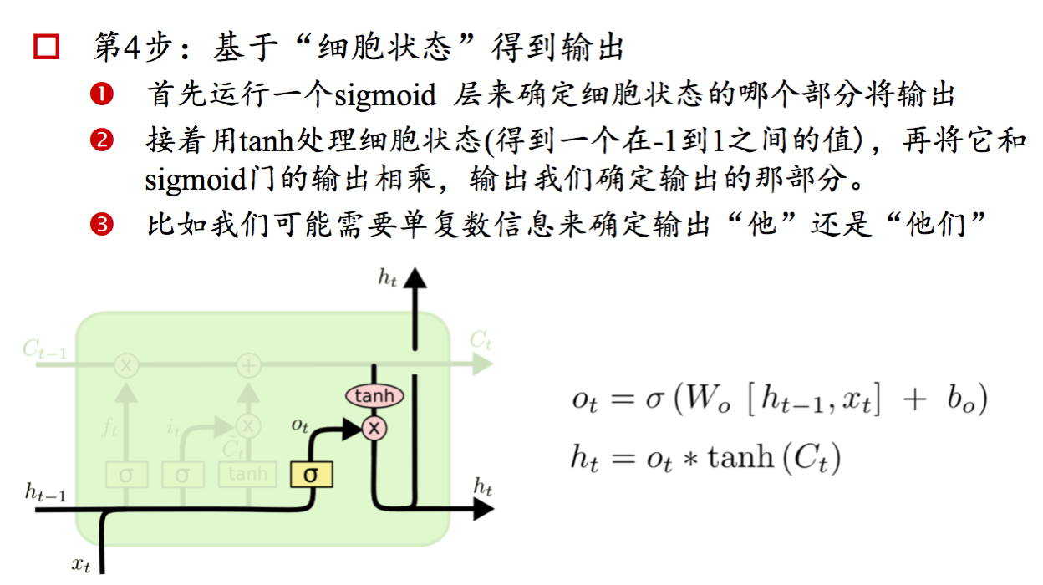
Sequence Model: LSTM Gates

Slide 30
Sequence Model: LSTM Gates

Slide 31
Sequence Model Use Case
Name Entity Recognition
Text Classification (Category/Sensitive)
Machine Translation
Image to Text

